Slide 1
Datadeploy
[
{"A":1,"B":2},
{"A":3,"B":4}
]
--> datadeploy( header,data,herokuapp)
header
A | B
1 | 2
3 | 4
https://myherokuapp.herokuapp.com/
data

Slide 2
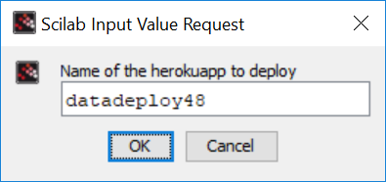
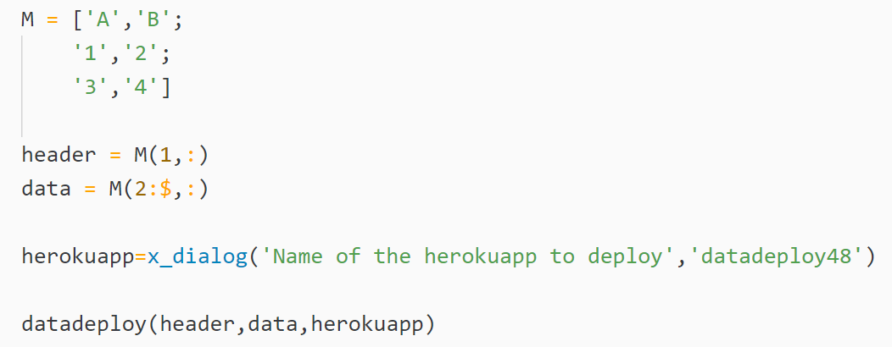
datadeploy
demo
demo_gui()

Slide 3


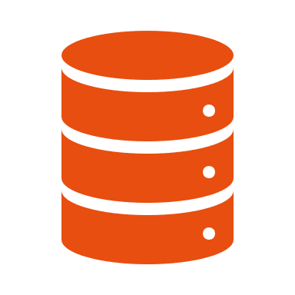


Datadeploy
Internal Workflow
plotdeploy

Slide 4


datadeploy
0. Import data
datadeploy

Slide 5
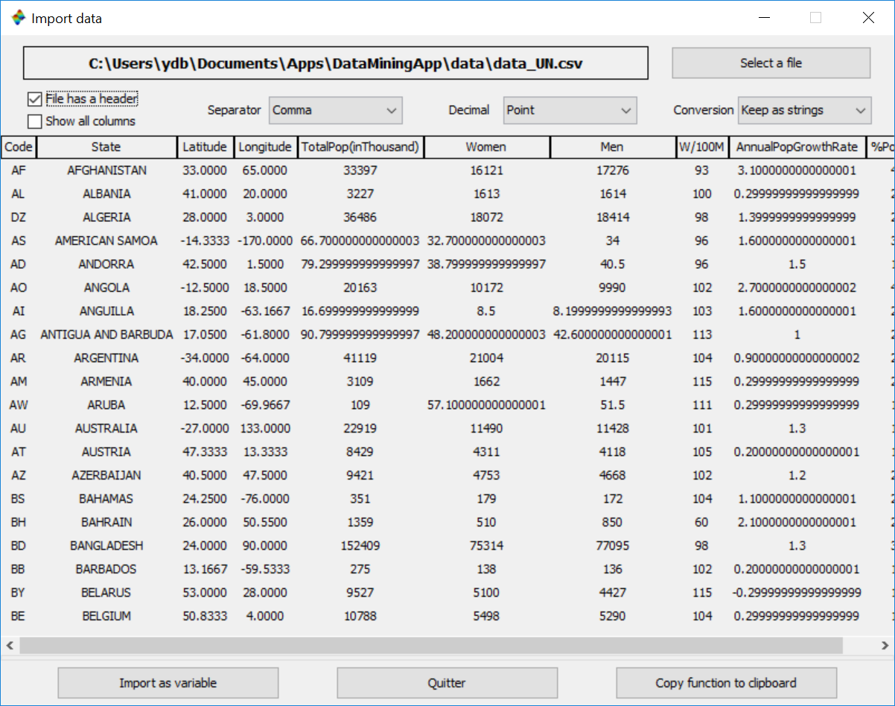
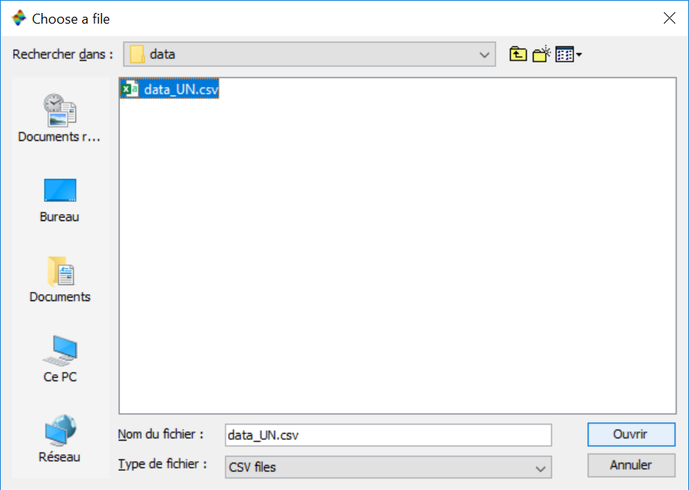
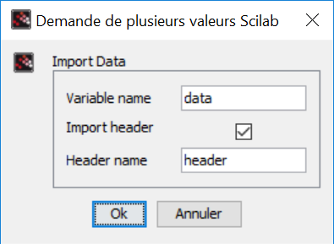
datadeploy
0. Import data

Slide 6
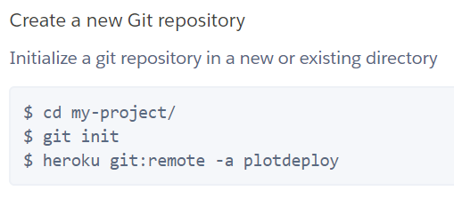
datadeploy
1. Git repo
datadeploy
--> [res1,res2] = gitinit(projectname)
res1 = "Initialized empty Git repository in C:/Users/ydb/AppData/Roaming/Scilab/scilab-6.1.1-alpha/datadeploy/.git/"
res2 = "set git remote heroku to https://git.heroku.com/datadeploy.git"

Slide 7
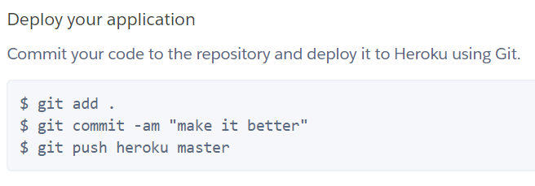
datadeploy
2. Heroku deployment
datadeploy

Slide 8
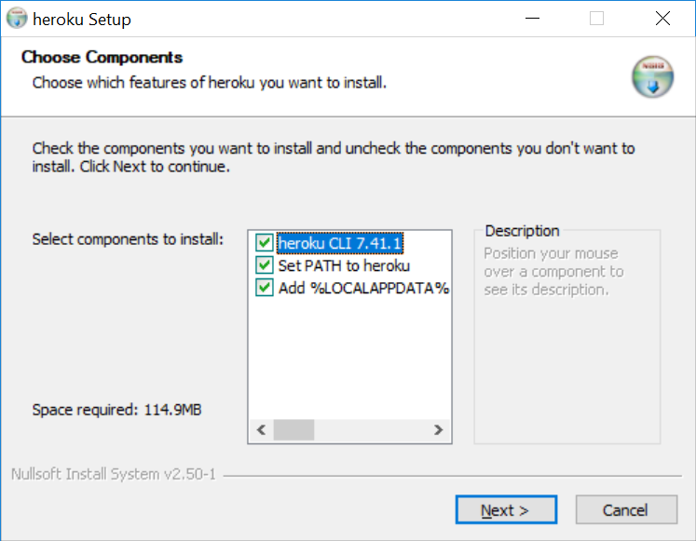
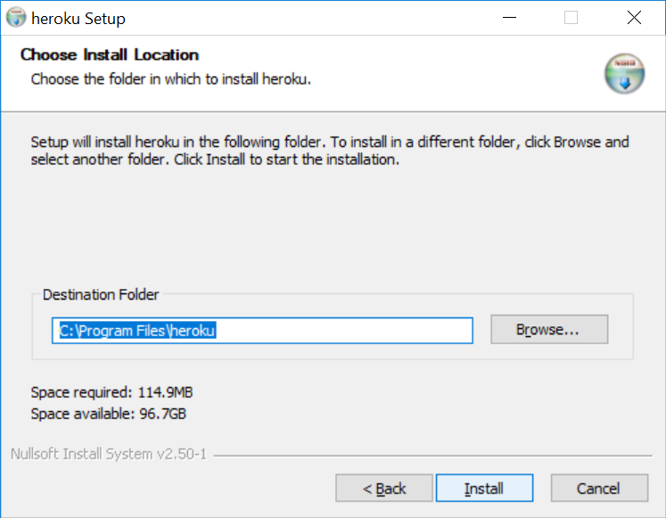
datadeploy
Heroku CLI install

Slide 9
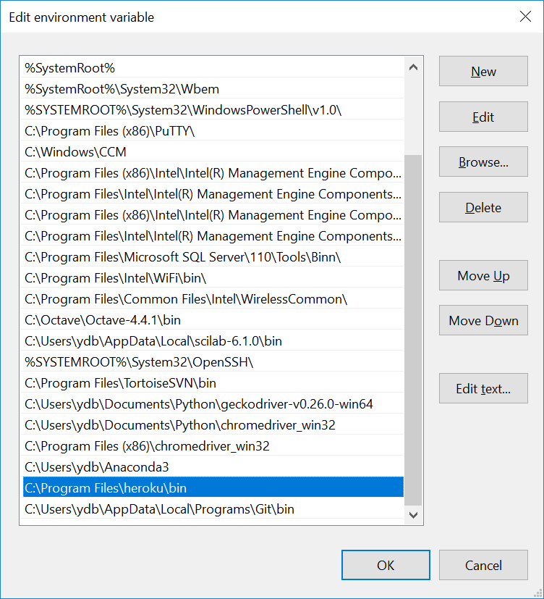
datadeploy
PATH / Environment variables
C:\Program Files\heroku\bin
C:\Users\ydb\AppData\Local\Programs\Git\bin

Slide 10
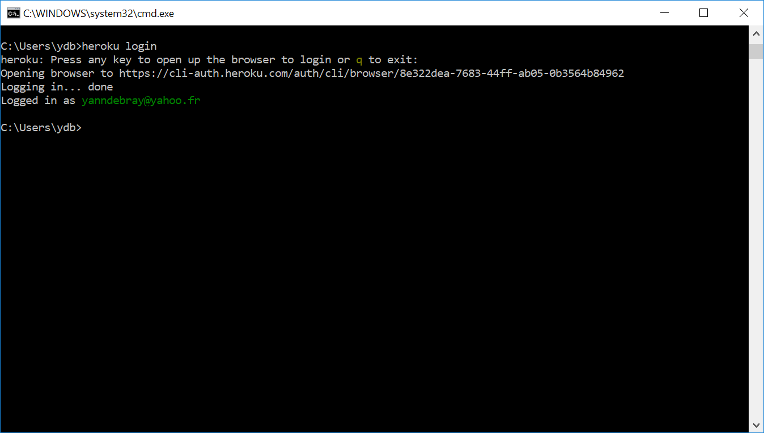
datadeploy
Heroku login

Slide 11
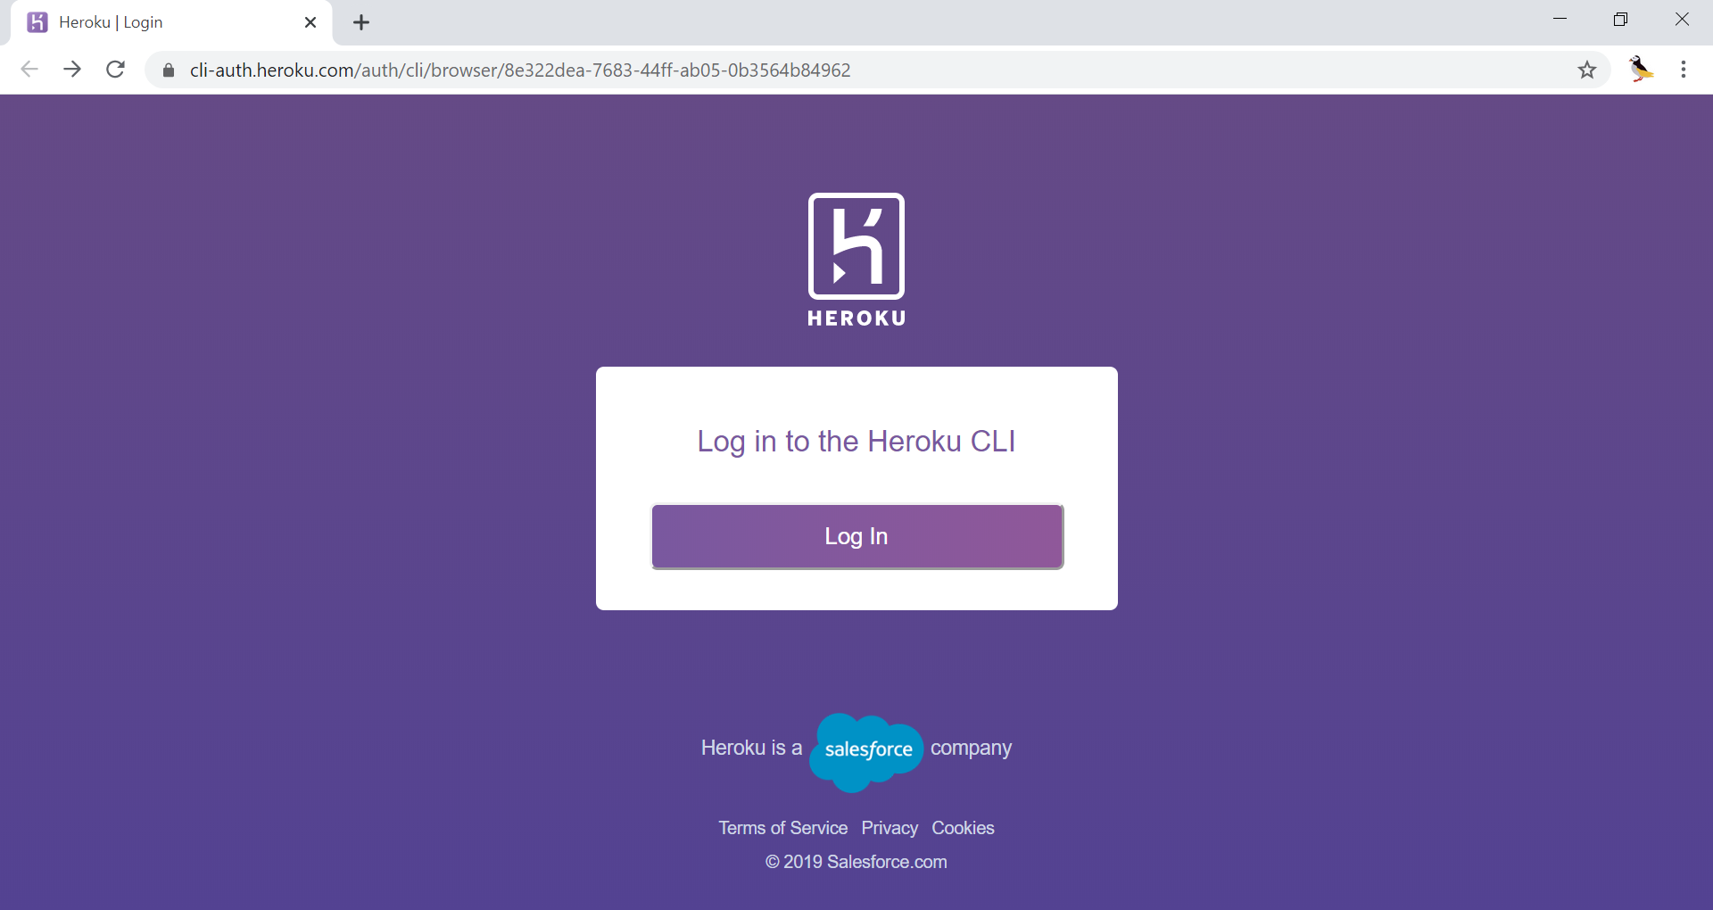

Slide 12
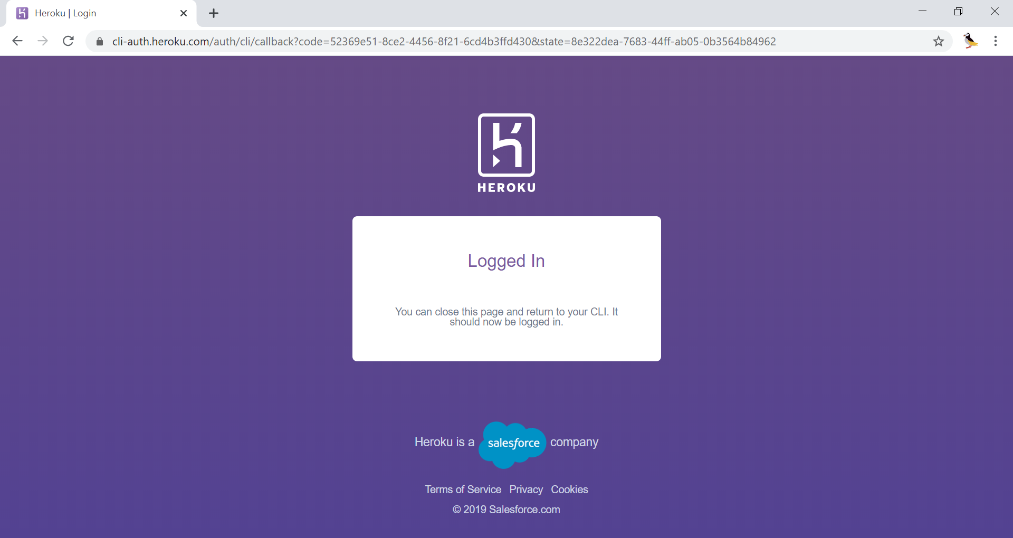

Slide 13
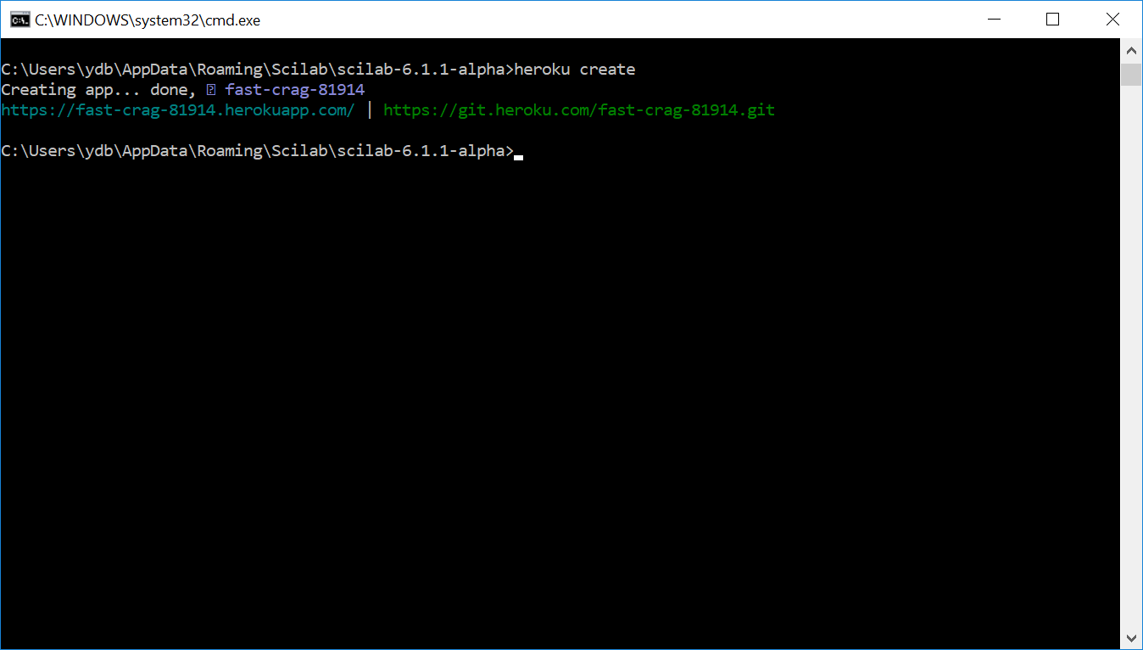
datadeploy
heroku create

Slide 14
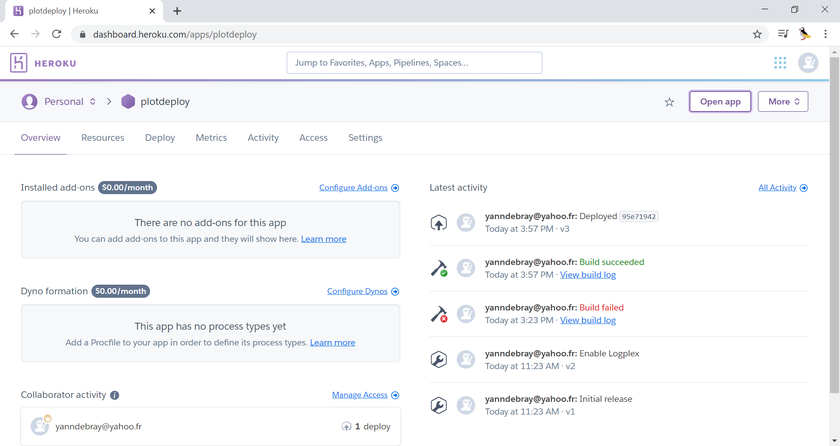
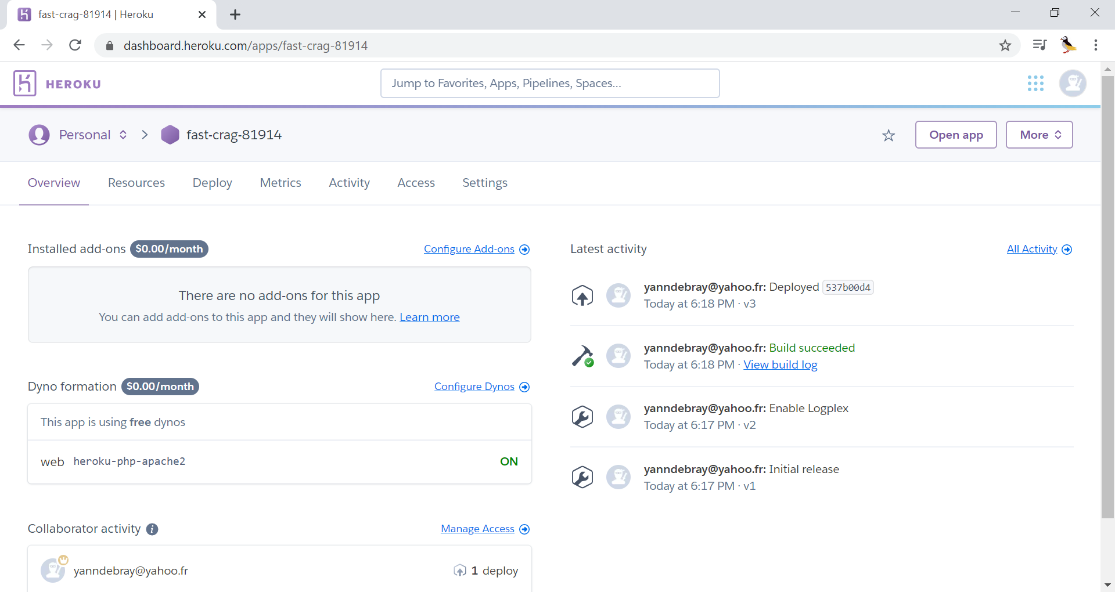

Slide 15
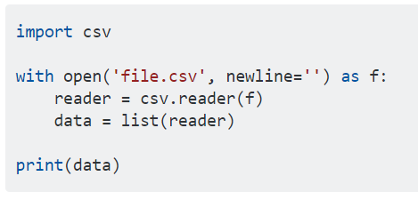
datadeploy
Sources
Using the csv module:
https://stackoverflow.com/questions/24662571/python-import-csv-to-list

Slide 16
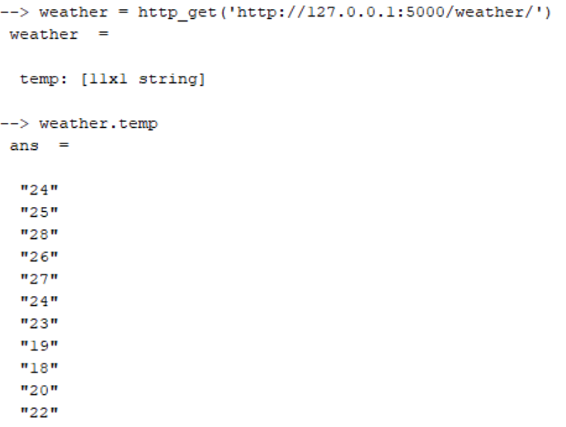
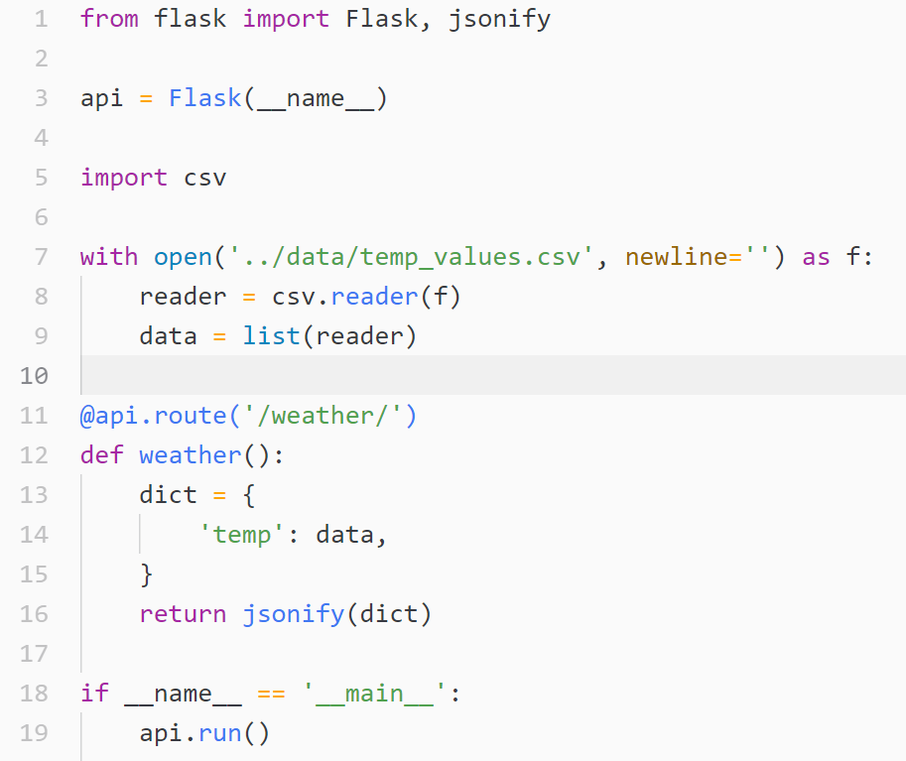
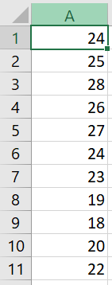
datadeploy
Vector 2 API

Slide 17
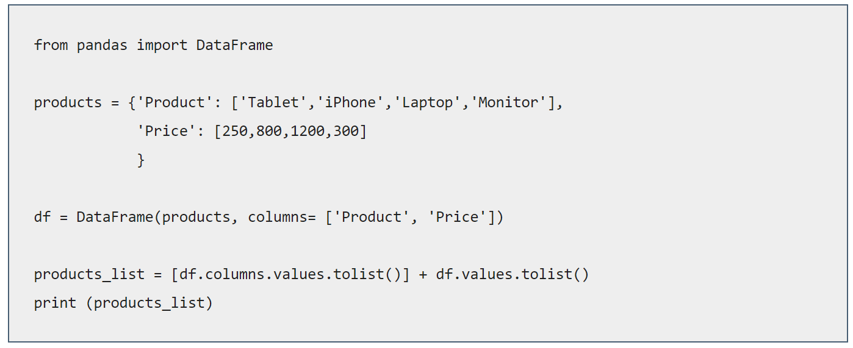
datadeploy
Matrix 2 API
df.values.tolist()
https://datatofish.com/convert-pandas-dataframe-to-list/

Slide 18
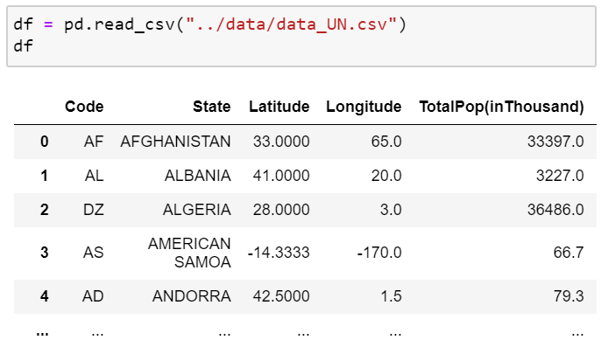
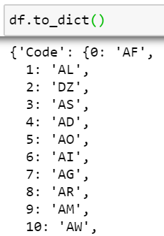
datadeploy
Dataframe 2 dictionnary
https://pandas.pydata.org/pandas-docs/stable/reference/api/pandas.DataFrame.to_dict.html

Slide 19
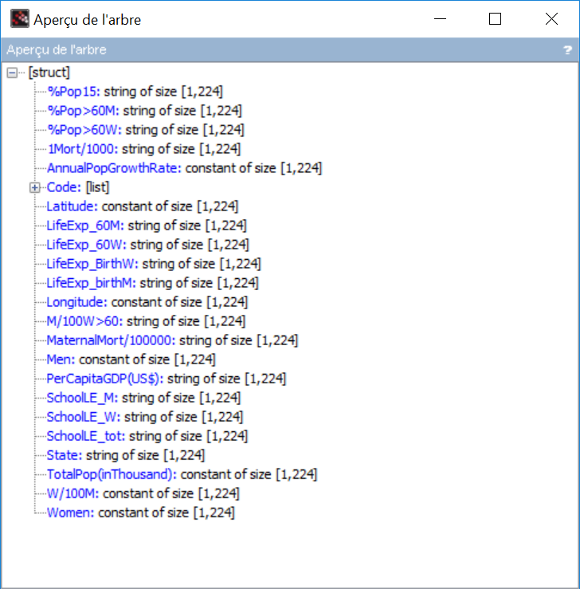
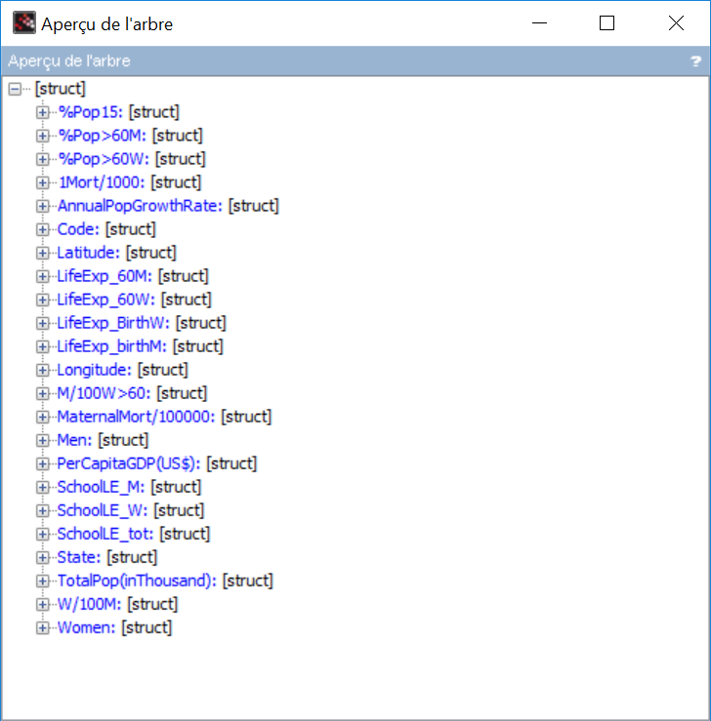
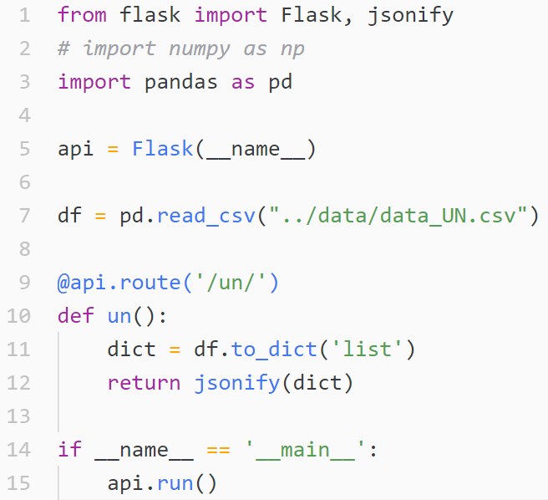
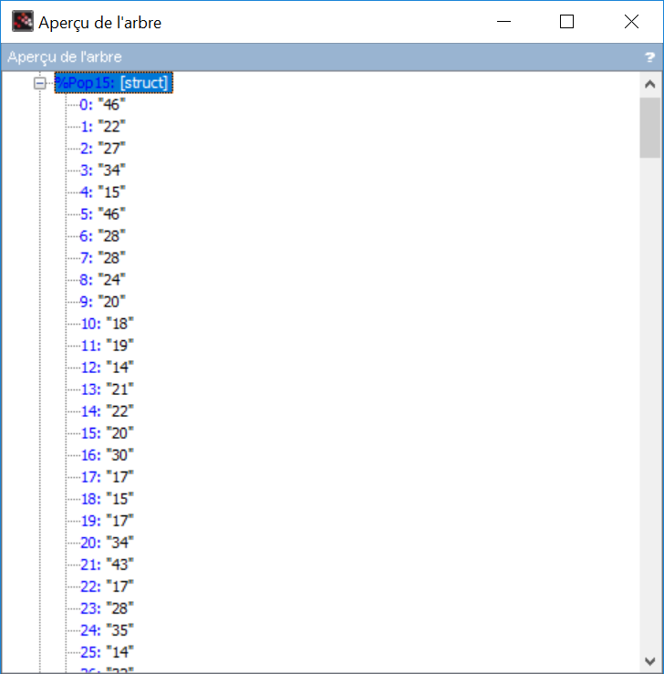
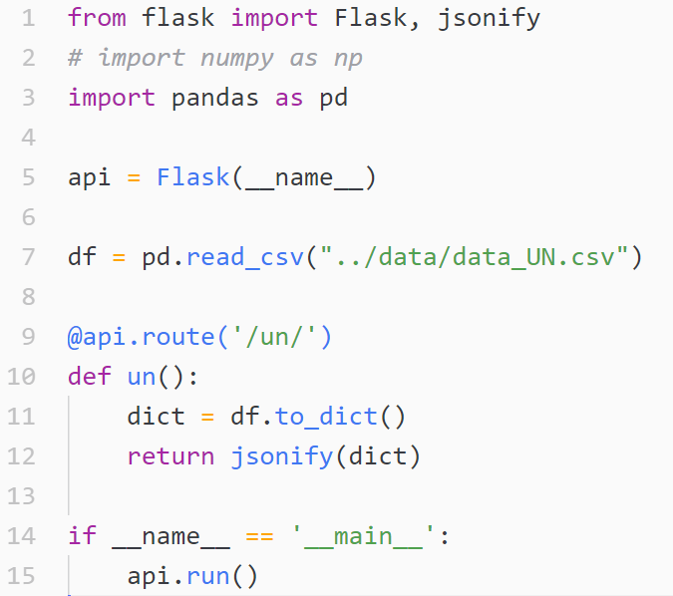
datadeploy
df 2 dict 2 json

Slide 20
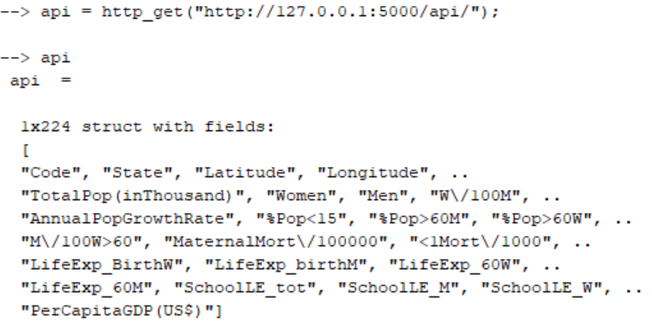
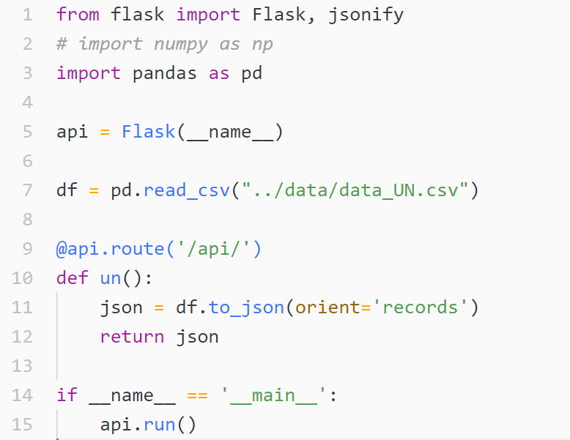
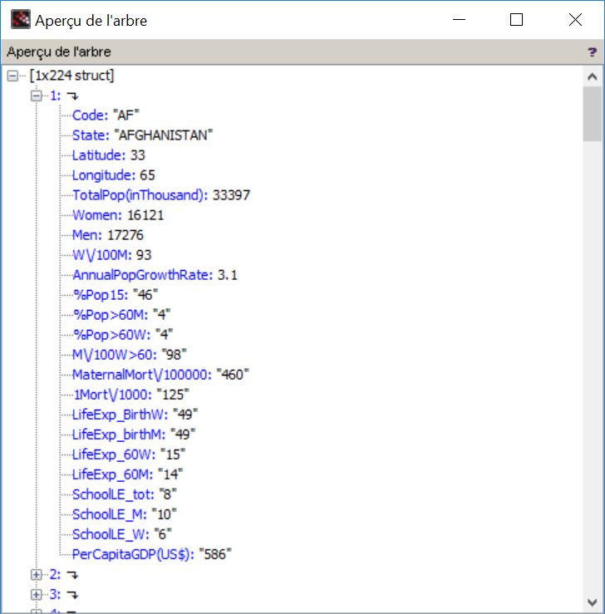
datadeploy
df 2 json
https://pandas.pydata.org/pandas-docs/stable/reference/api/pandas.DataFrame.to_json.html

Slide 21
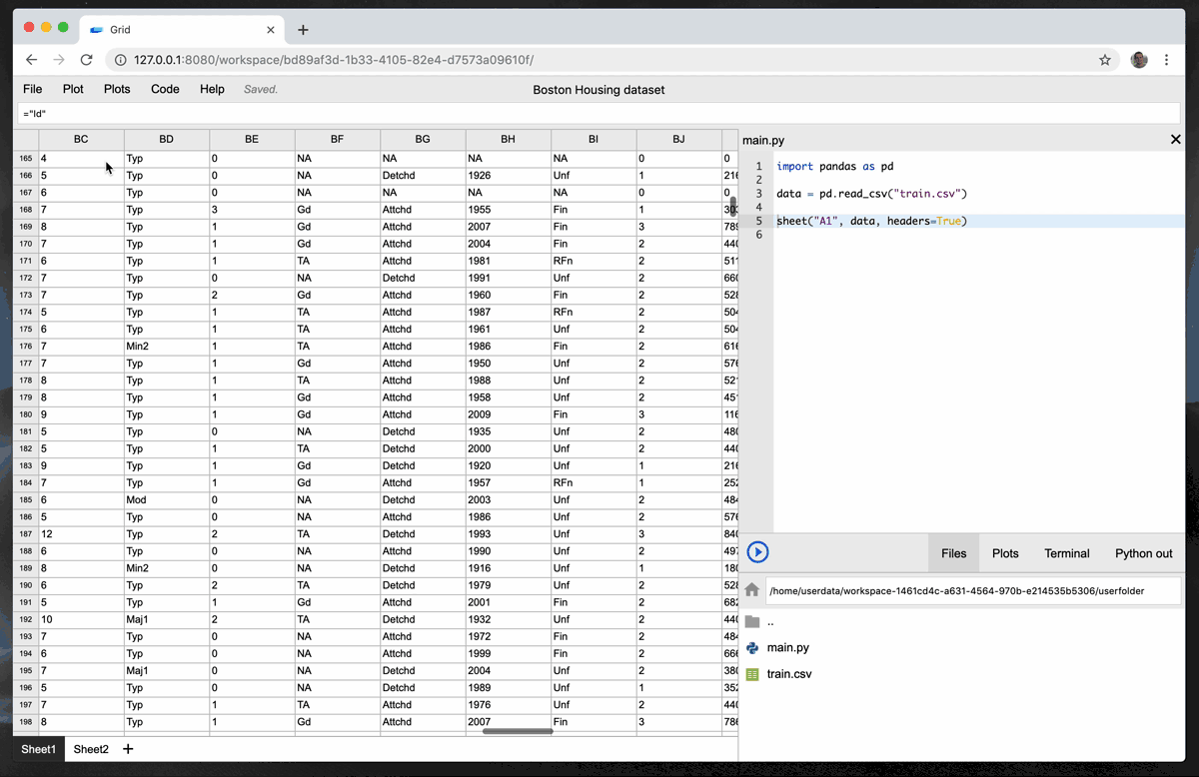
datadeploy
Inspiration: Grid Studio
https://hackernoon.com/introducing-grid-studio-a-spreadsheet-app-with-python-to-make-data-science-easier-tdup38f7

Slide 22
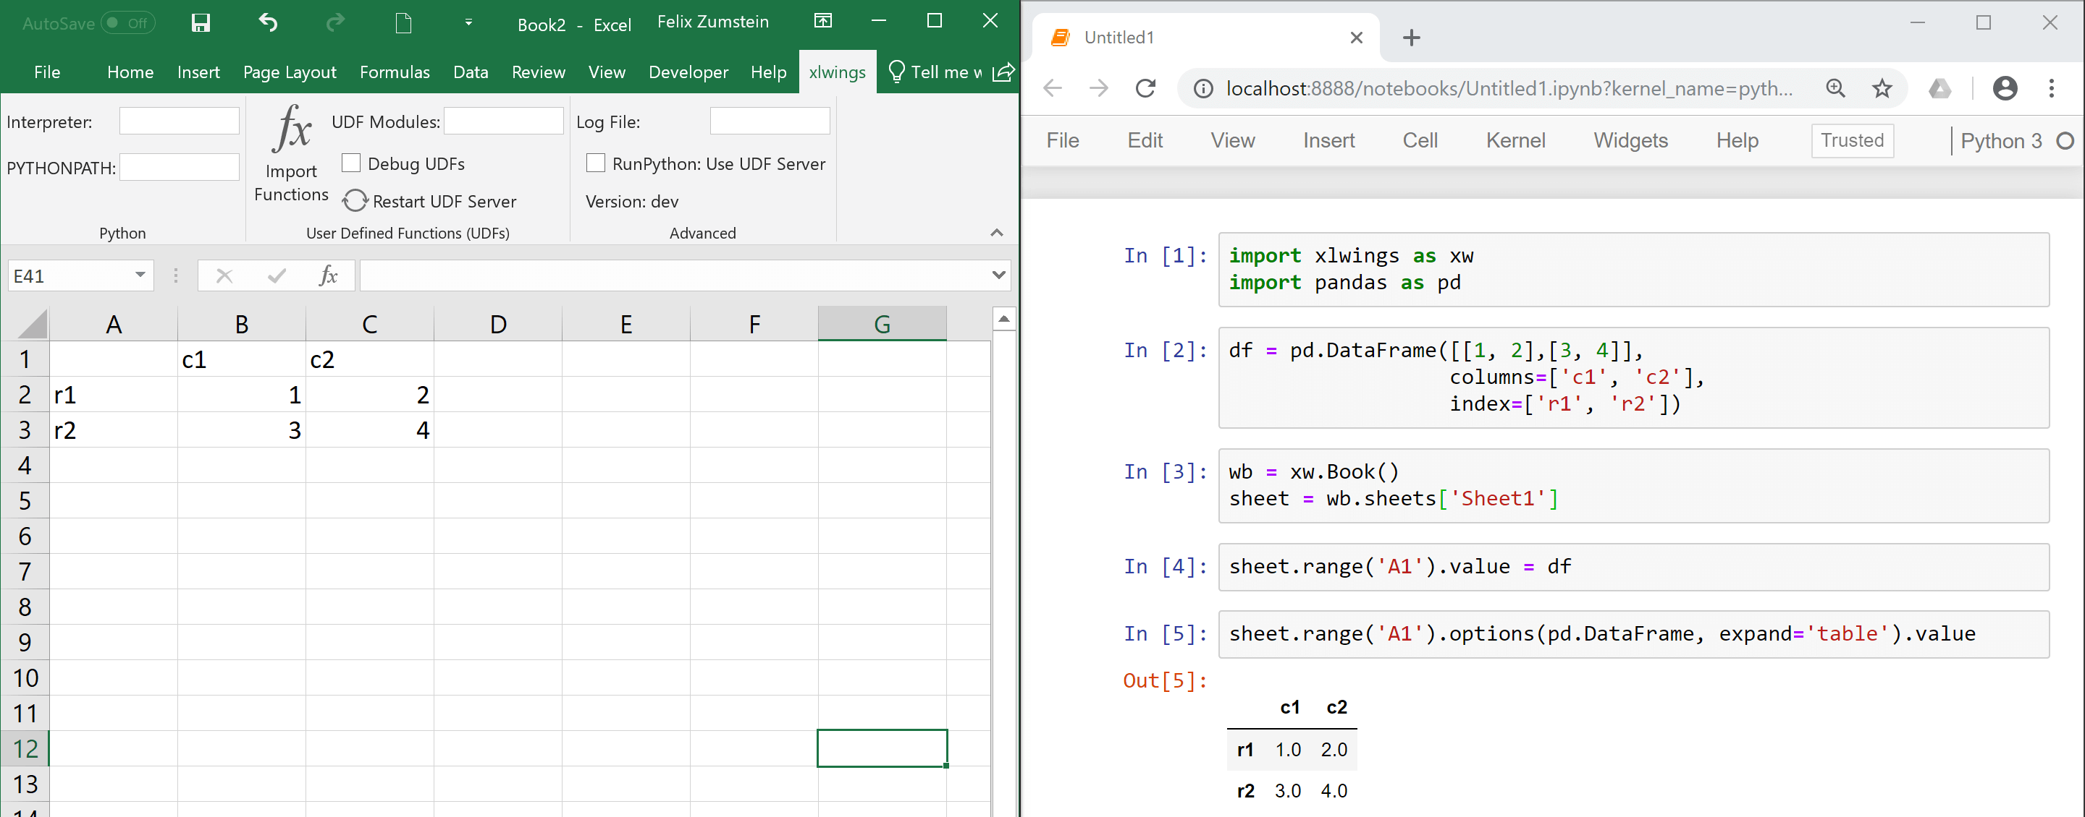
datadeploy
Inspiration: xlwings
https://www.xlwings.org/
https://docs.xlwings.org/en/stable/rest_api.html

